Slide 1
Breast Cancer Patients Survival Prediction With Machine Learning Models
TRGN 515
Eun Kyu Sung

Slide 2
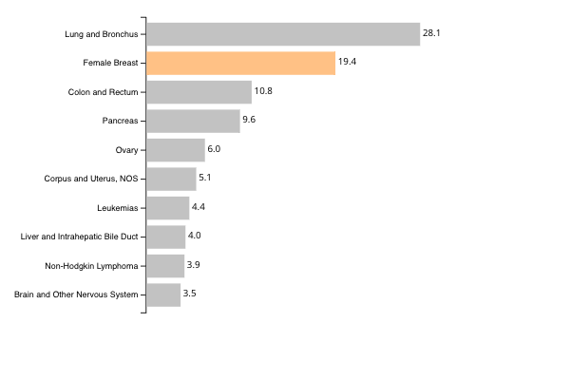
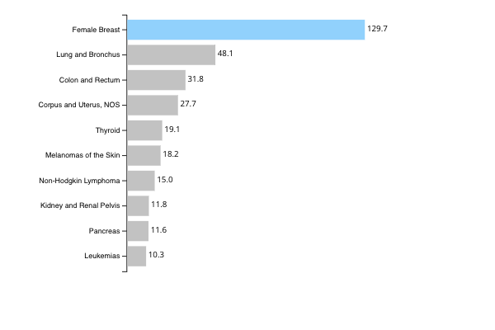
Top 10 Cancers by Rates of New Cancer Deaths
United States, 2019, All Races and Ethnicities, Female
Top 10 Cancers by Rates of New Cancer Cases
United States, 2019, All Races and Ethnicities, Female
Rate per 100,000 women
Source - U.S. Cancer Statistics Working Group. U.S. Cancer Statistics Data Visualizations Tool, based on 2021 submission data (1999-2019): U.S. Department of Health and Human Services, Centers for Disease Control and Prevention and National Cancer Institute; https://www.cdc.gov/cancer/dataviz, released in November 2022.
Notes:
About 42,000 women in the U.S. die each year from breast cancer

Slide 3
Aim of the Study
Because of the high mortality rate of breast cancer, predicting survival of the breast cancer patients may improve their care with necessary care plans thereby it would improve their survival rate.
Predict survival of breast cancer patients using machine learning models with both clinical and gene expression profiles

Slide 4
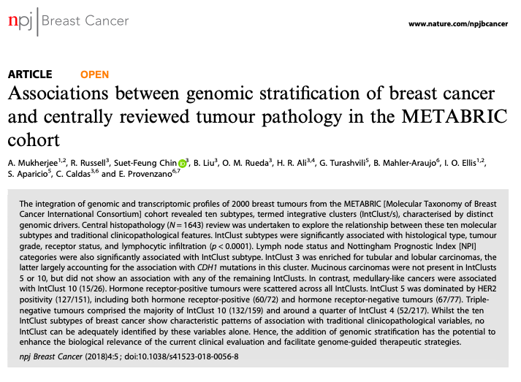
About Dataset
Molecular Taxonomy of Breast Cancer International Consortium (METABRIC)
Looked at patterns of molecules inside tumors from nearly two thousand women
Classified the breast cancer into 10 different homogenous groups in terms of genetic alteration
Download the dataset from Kaggle
https://www.kaggle.com/datasets/raghadalharbi/breast-cancer-gene-expression-profiles-metabric/download?datasetVersionNumber=1

Slide 5
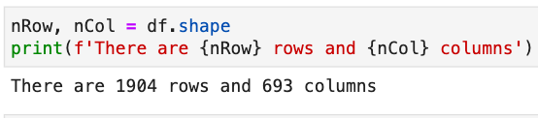
Data Structures
Clinical Data includes 31 clinical attributes
Gene Expression Data includes mRNA levels z-score of 331 genes
Single Nucleotide Polymorphism (SNP) of 175 genes. (ex. G325R)

Slide 6
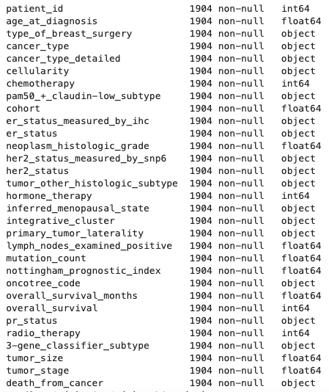
Clinical Data Attributes
Data type:
14 Numeric variables
17 Categorical variables
Redundant features
ER status measured by ihc and ER status
Many attributes are derived from genetic information
HER2 status measured by SNP6
PAM50 claudin low subtype

Slide 7
Details of Clinical Data Attributes
PAM50 – 50-gene signature that classifies breast cancer into five molecular intrinsic subtypes: Luminal A, Luminal B, HER2-enriched, Basal-like, and Normal-like
Integrative cluster – Molecular subtype of the cancer based on some gene expression and DNA copy number alteration
3 gene classifier subtype – Subtyping the breast cancer based on the key breast cancer gene: ER, HER2, Aurora Kinase A (AURKA)
Nottingham prognostic index – Calculated value using 3 pathological criteria: size of tumor, grade of tumor, and number of involved lymph nodes after surgery (greater than 5.4 means 50% 5-years survival)
OncoTree code – Classification of cancers that includes 868 tumor types across 32 organ site

Slide 8
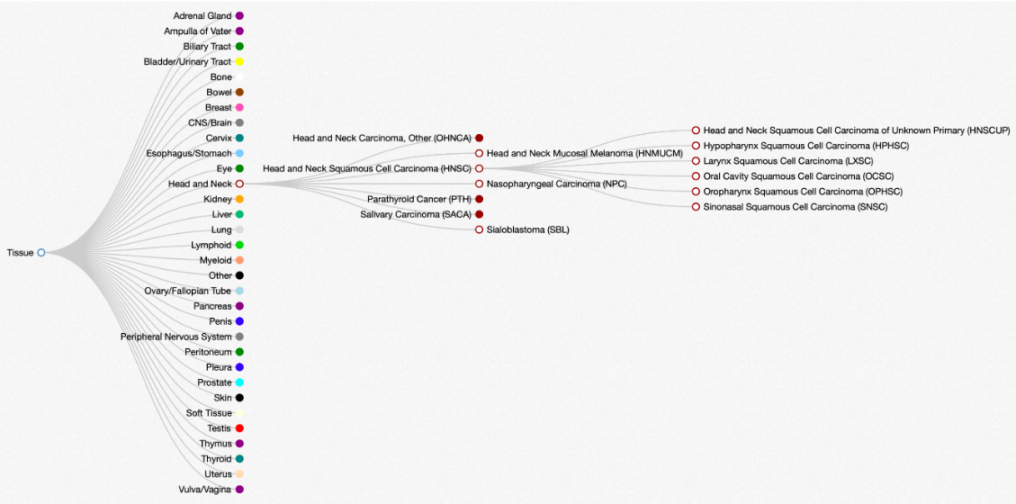
OncoTree

Slide 9
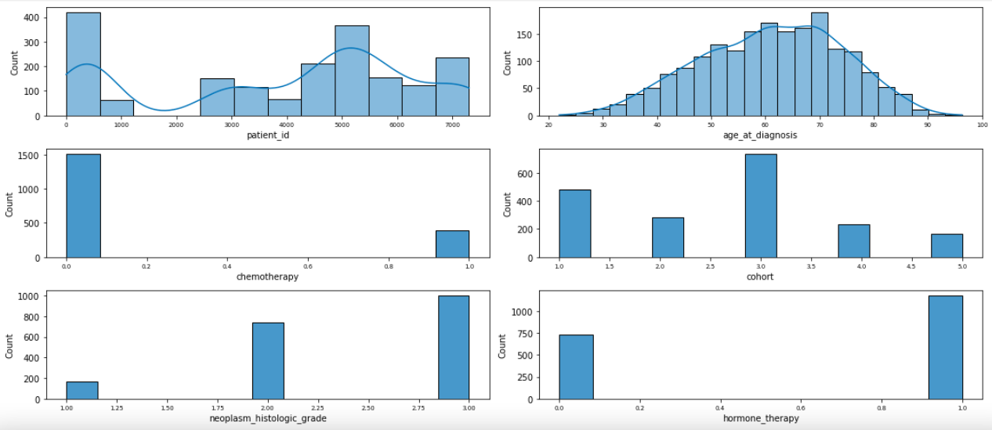
Distribution of Clinical Attributes

Slide 10
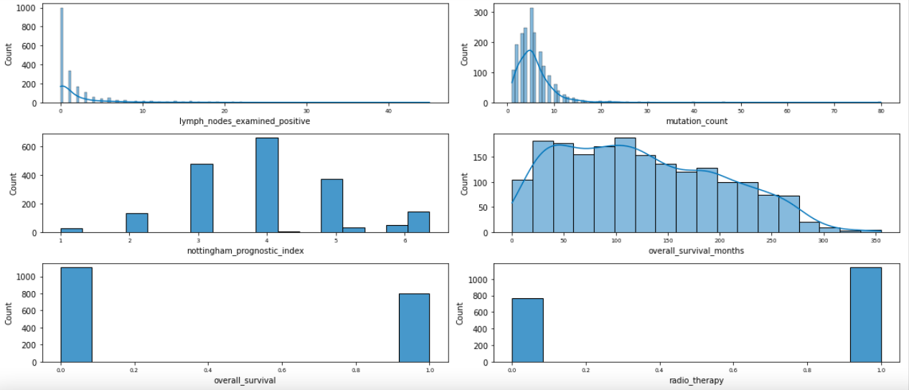
Distribution of Attributes in Clinical Data

Slide 11
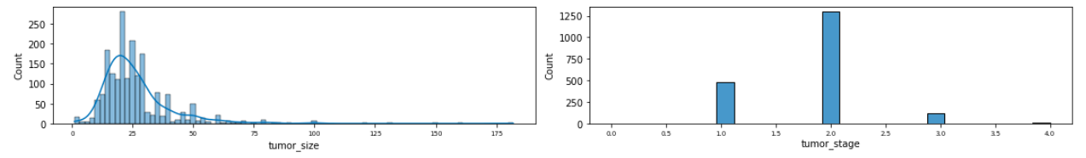
Distribution of Attributes in Clinical Data

Slide 12
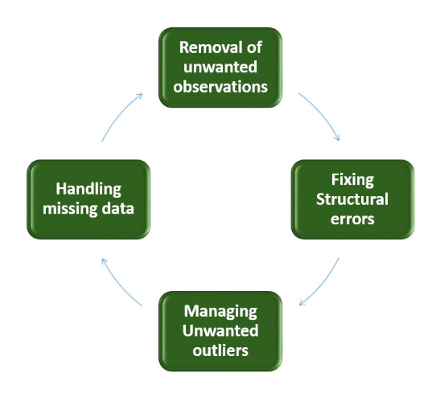
Data Cleaning
Image source - https://algodaily.com/lessons/introduction-to-data-cleaning-and-wrangling

Slide 13
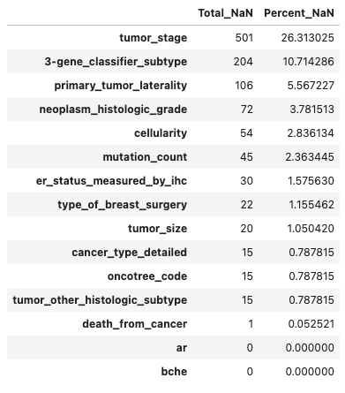
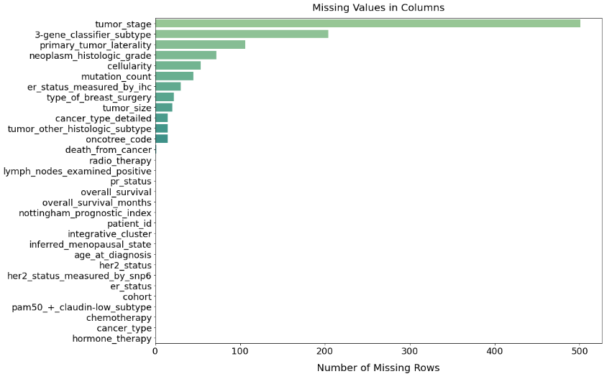
Missing Values

Slide 14
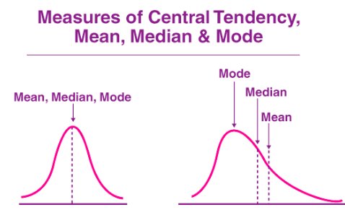
How I handle Missing Values
Continuous variables
Missing values -> Mean (for normal distribution) or Median (for skewed distribution)
Categorical variables
Missing values -> Mode
Image source - https://byjus.com/maths/mean-median-mode/
Notes:
Add info for mean median

Slide 15
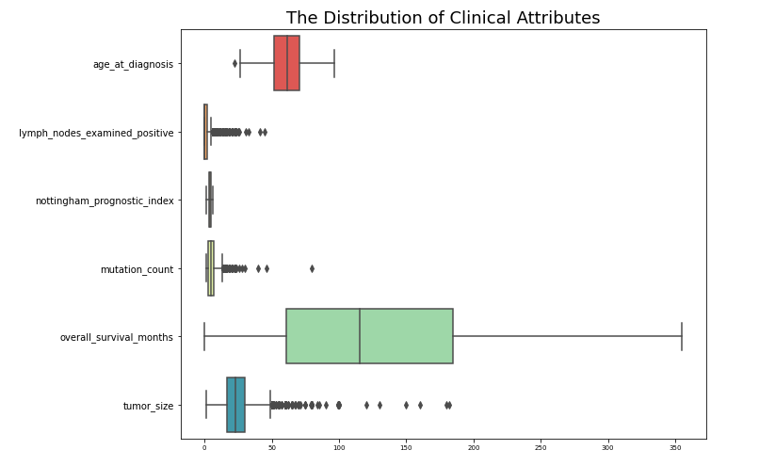
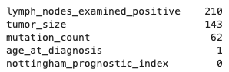
Outliers in Clinical Data

Slide 16
Outliers
Dropping outliers from a dataset
Transformation/Normalization Methods
Scaling
Value = (X – mean) / stdev
Log Transformation
Value = log₁₀(X)
Cube Root Normalization
Value = X^{1/3}
Notes:
equations

Slide 17
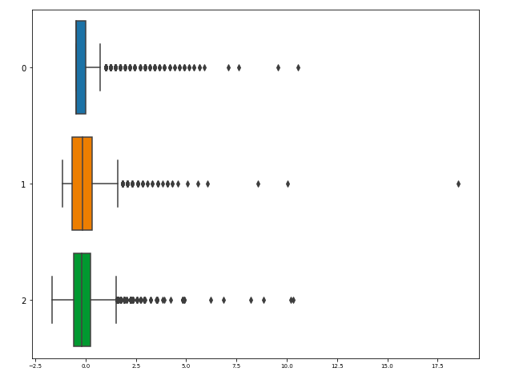
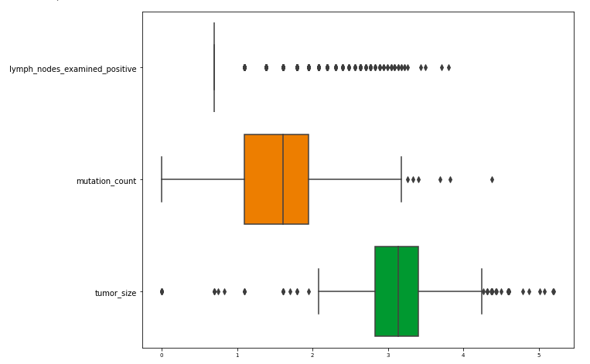
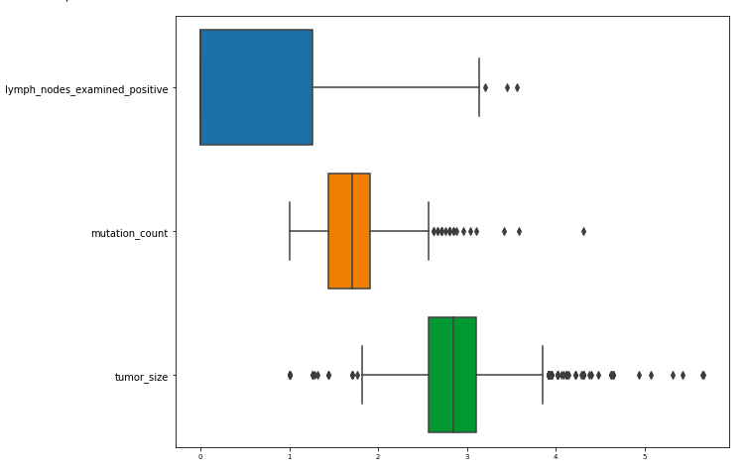
Scaling
Log Transformation
Cube Root Normalization
Top (blue): Lymph nodes examined positive
Middle (orange): Mutation count
Bottom (green): Tumor size
Notes:
Put all everything in one

Slide 18
Reduce Redundant data
What does data redundancy mean?
A field of a dataset is a duplicated of the other field or highly correlated in same dataset
This adding bias to interpretation of a dataset
Usually overlapped fields are dropped
Correlation coefficient ≥ |.5| considered as a strong or large correlation

Slide 19
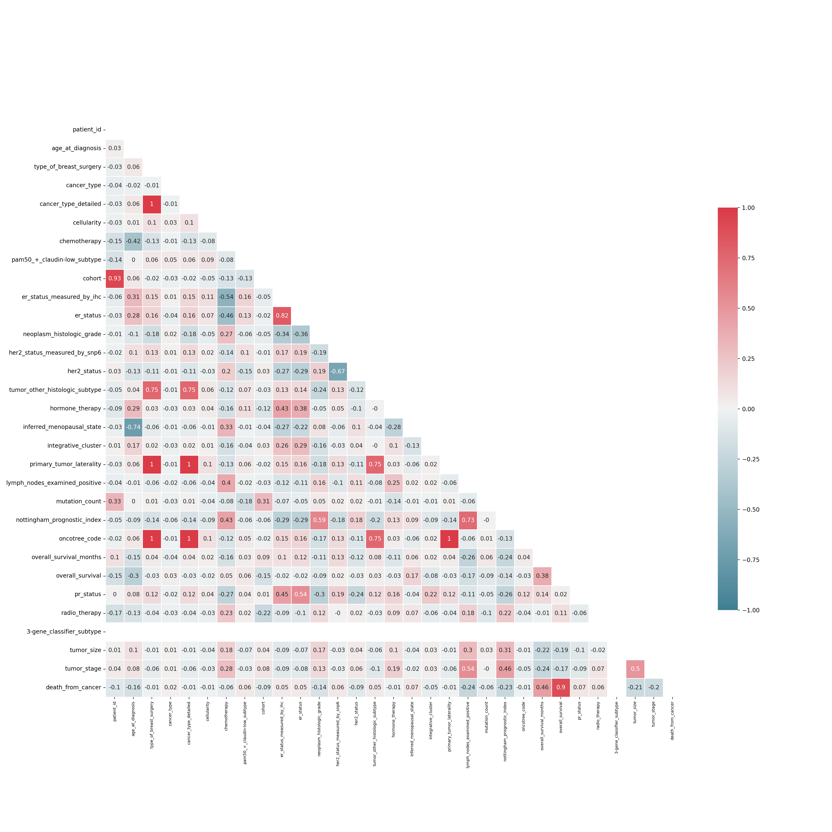
Correlation Heatmap

Slide 20
Correlation Heatmap

Slide 21
Correlation Heatmap

Slide 22
Results from Correlation Heatmap
Set an arbitrary correlation coefficient cutoff as ≥ |.7|
15 fields fit into this cutoff line and 8 of them are dropped: “cancer type detailed”, “tumor other histologic subtype”, “oncotree code”, “primary tumor laterality”, “inferred menopausal state”, “er status measured by ihc”, “lymph nodes examined positive”, “death from cancer”
Correlation coefficient between “her2 status measured by snp6” and “her2 status” was -0.67

Slide 23
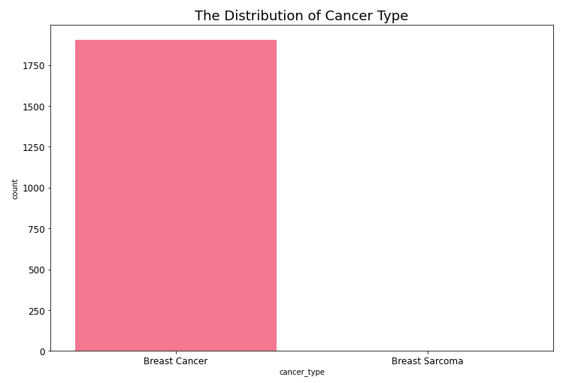
Filtering More Fields Out
“patient id” and “cancer type” are not useful information.
I dropped the fields with missing values or outliers if I had a choice to drop

Slide 24
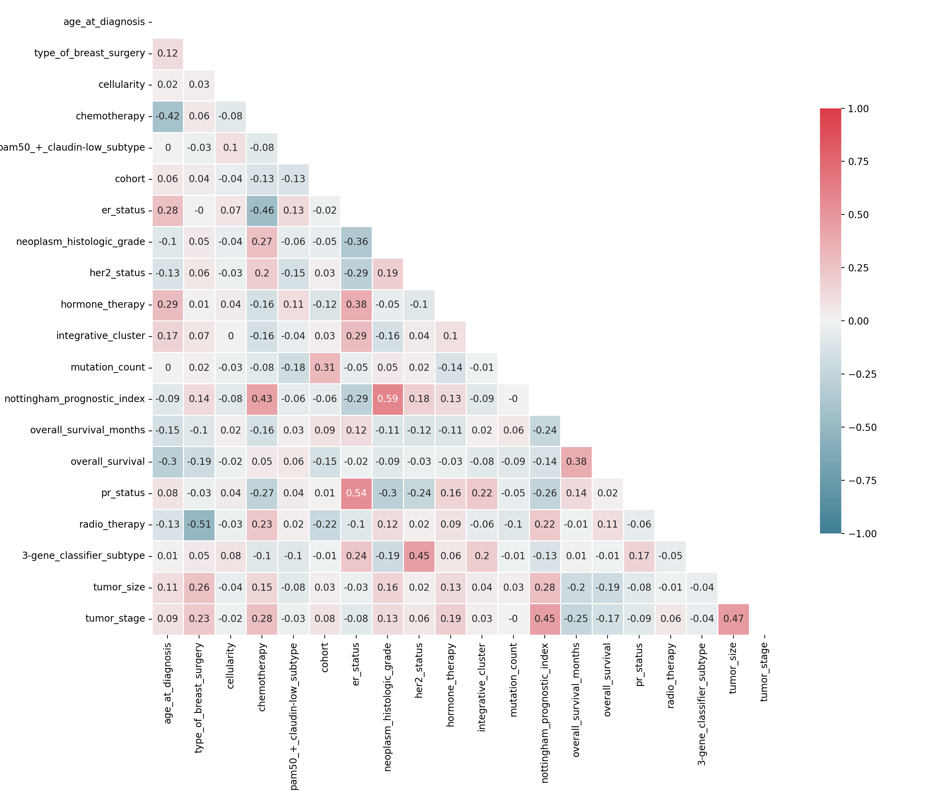
Correlation Heatmap After Filtering

Slide 25
Target Variable
Overall survival month
Duration from the time of the intervention to death (interval)
Overall survival
Target variable whether the patient is living or dead. (living/dead)
Death from cancer
Whether the patient's death was due to cancer or not (living/dead by cancer/dead by other cause)

Slide 26
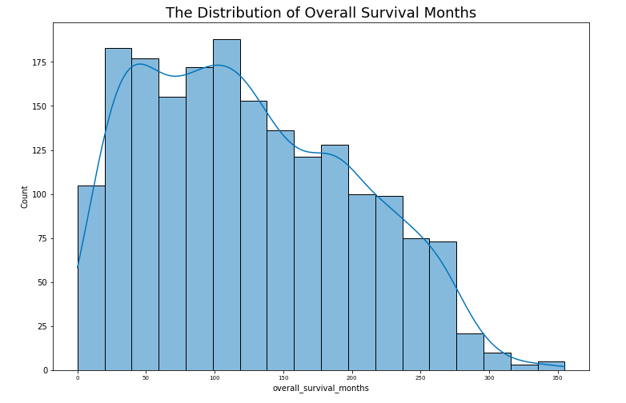
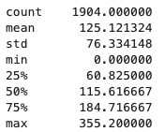
Overall Survival Months Distribution
Notes:
Add what is meaing of them

Slide 27
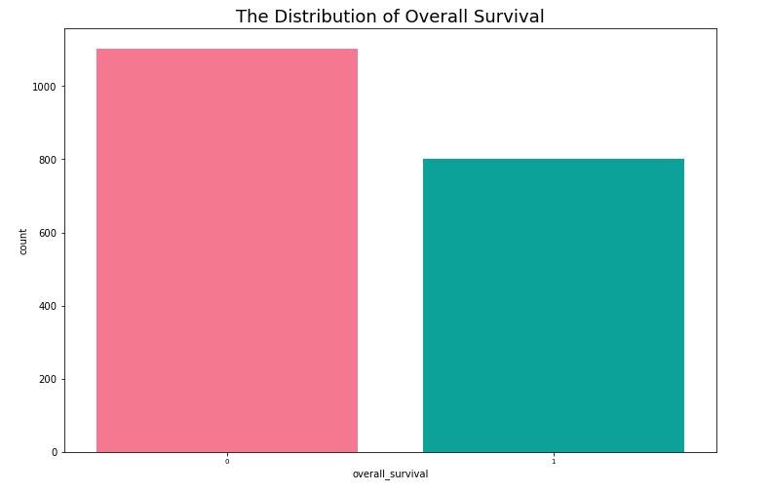
Overall Survival Distribution
0 : Dead
1 : Living

Slide 28
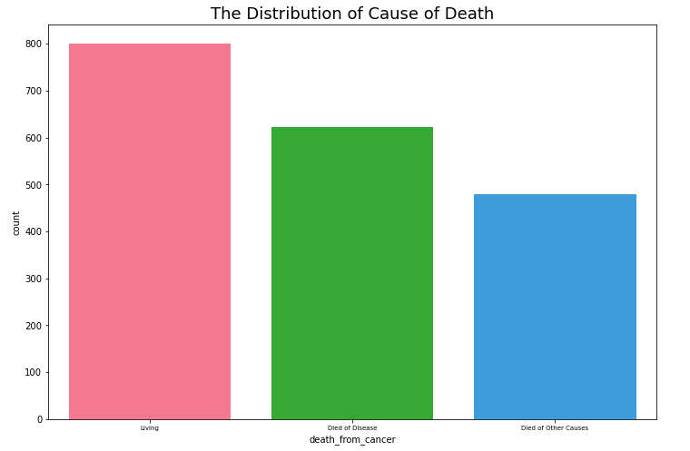
Death From Cancer Distribution

Slide 29
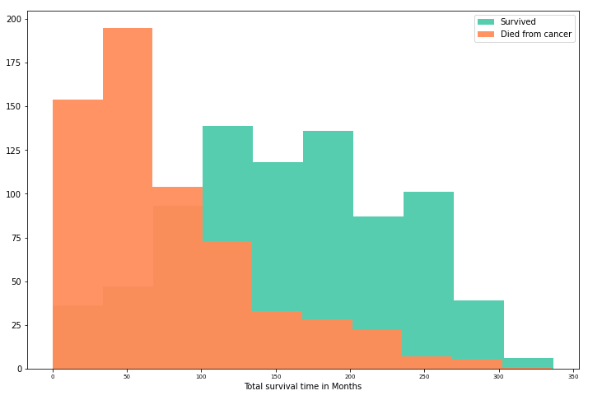
Distribution of Survival with Target Attribute

Slide 30
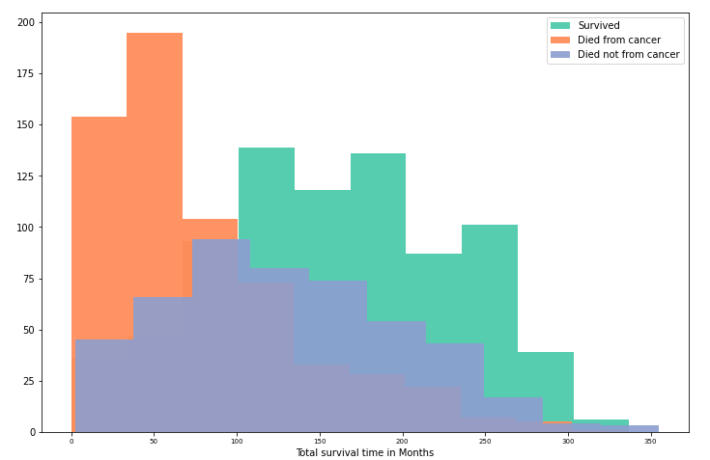
Distribution of Survival with Target Attribute

Slide 31
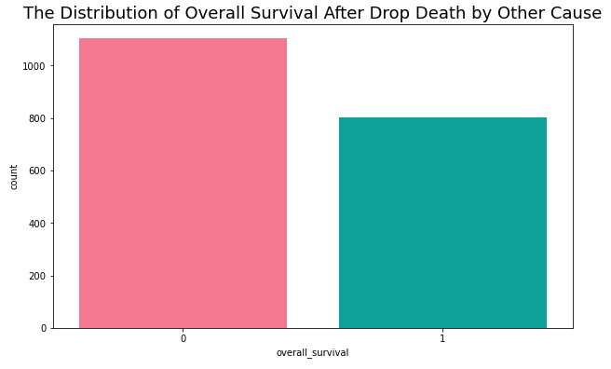
The Distribution of Overall Survival After Drop Death by Other Cause
0 : Living
1 : Dead
58%
42%

Slide 32
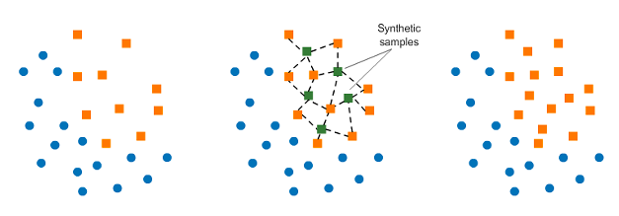
Class Imbalance Synthetic Minority Oversampling Technique (SMOTE)
Image source - https://www.analyticsvidhya.com/blog/2020/07/10-techniques-to-deal-with-class-imbalance-in-machine-learning/
Notes:
Computing K-nearest neighbors

Slide 33
Machine Learning
What is machine learning in data science?
A branch of artificial intelligence (AI) and computational science, which focuses on the use of data and algorithms to imitate the way that humans learn, gradually improving its accuracy.
Allow us to analyze an immense amount of data efficiently in a timely manner and to make data-driven decision making

Slide 34
Machine Learning Methods
Supervised machine learning
Use of labeled datasets to train algorithms to classify data or predict outcomes accurately
Linear/Logistic Regression, Decision Tree, Random Forest
Unsupervised machine learning
Analyze and cluster unlabeled datasets to discover hidden pattern and group.
K-mean Clustering, Principal Component Analysis (PCA)

Slide 35
Major Steps of Machine Learning
Split a data into train(Learning) and test(Unseen) Dataset
70:30
Choose a model
Logistic regression, Decision tree, Random forest
Train the model with the train dataset
Evaluate the model with the test dataset
Hyperparameter tuning
GridSearchCV
Notes:
Training

Slide 36
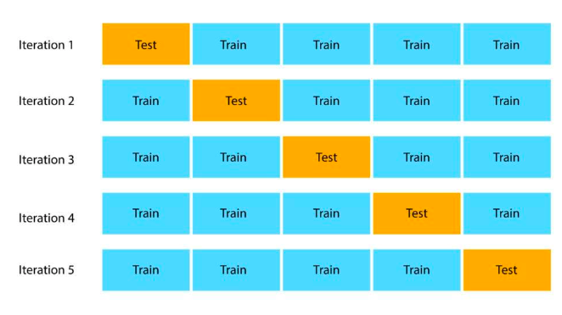
GridSearchCV
Cross validation technique
Performing hyperparameter tuning and determine optimal values for a given model
Image source - https://www.datasciencecentral.com/hyperparameter-tuning-techniques-in-machine-learning-engineering/

Slide 37
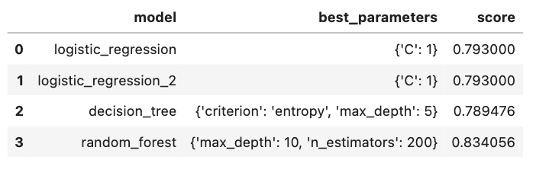
Models Training with Clinical Data Results
$$SCORE=ACCURACY=\frac{Total number of correct prediction}{Total number of prediction attempt}$$
Notes:
Accuracy eq.

Slide 38
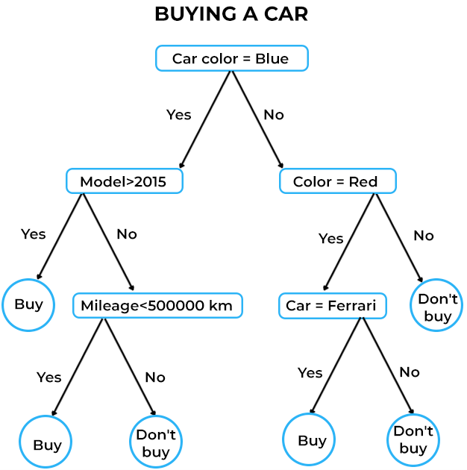
Tree-based Model
Image source - https://www.spiceworks.com/tech/artificial-intelligence/articles/what-is-decision-tree/

Slide 39
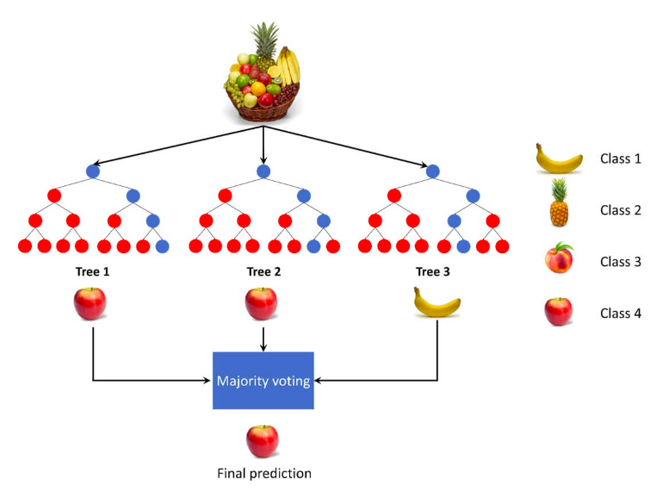
Random Forest
Collection of decision tree
Randomly select observations and build a set number of decision trees and take an averages of them.
Hyperparameter: max_depth & n_estimators
Image source - https://datahacker.rs/012-machine-learning-introduction-to-random-forest/
Notes:
What is decision tree.

Slide 40
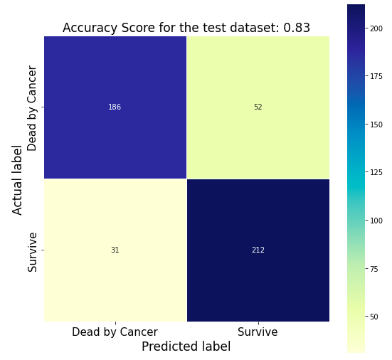
Random Forest Test Results
True Positive (TP): Patients who survived were classified as survived (Bottom Right)
True Negative (TN): Patients who died were classified as died (Top Left)
False Positive (FP): Patients who died and were classified as survive (Top Right)
False Negative (FN): Patients who survive and were classified as died (Bottom Left)

Slide 41
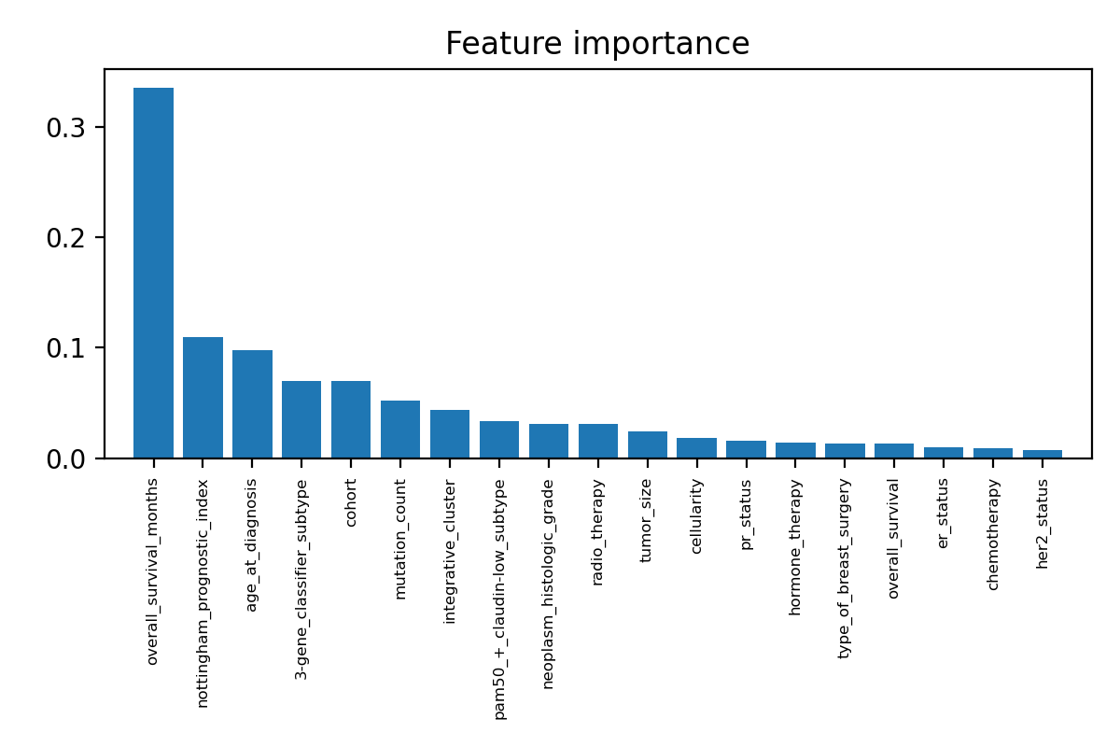
Random Forest Test Results
Notes:
Simply higher the number means the higher the importance of the variable in the model

Slide 42
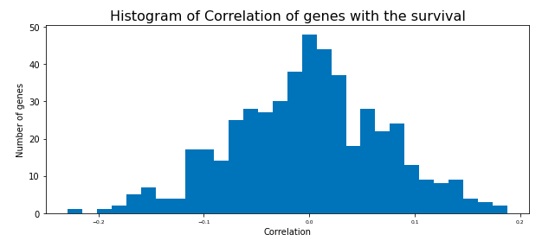
Correlation Distribution of Gene Expression Data

Slide 43
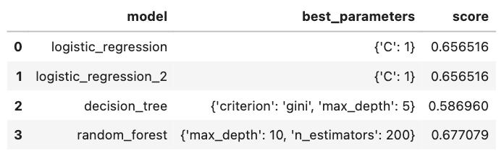
Models Training with Expression Data Results
$$SCORE=ACCURACY=\frac{(True positive+True negative)}{Total number of instance}$$

Slide 44
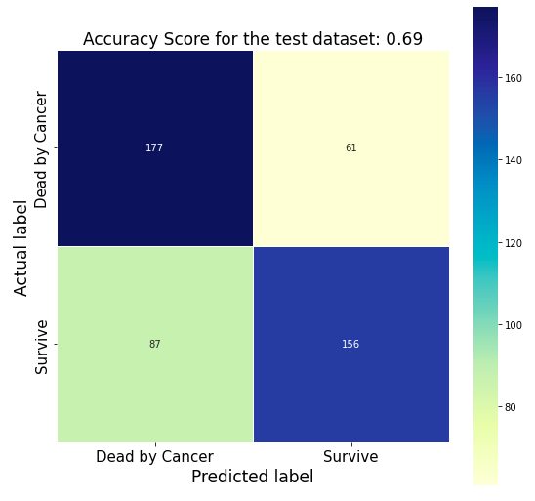
Random Forest Test Results
True Positive (TP): Patients who survived were classified as survived (Bottom Right)
True Negative (TN): Patients who died were classified as died (Top Left)
False Positive (FP): Patients who died were classified as survived (Top Right)
False Negative (FN): Patients who survive were classified as died (Bottom Left)

Slide 45
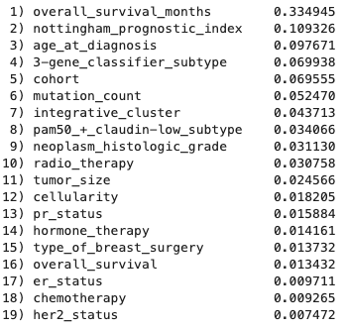
Feature Selection
Random forest features importance
Cannot attain overall survival months until patient death
Molecular information
3-gene classifier subtype, cohort, integrative cluster, pam50 claudin-low subtype, pr status, er status, her2 status

Slide 46
Correlation Heat Map
Order
Age at diagnosis
Nottingham prognostic index
Neoplasm histologic grade
Cellularity
Nottingham prognostic index and Neoplasm histologic grade show high correlation with gene expression

Slide 47
Correlation Heat Map
Order
Radio therapy
Hormone therapy
Breast surgery
Chemotherapy
Chemotherapy shows high correlation with gene expression

Slide 48
Correlation Heat Map
Order
Mutation count
Tumor stage
Tumor size
Mutation count and Tumor size show high correlation with gene expression

Slide 49
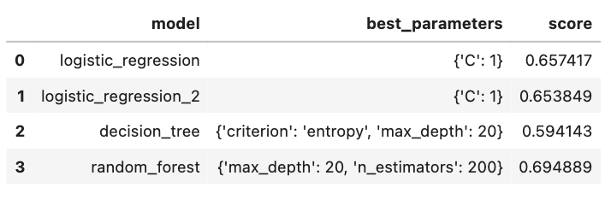
Selected Clinical Data and Gene Expression Data Results from Model Training
$$SCORE=ACCURACY=\frac{(True positive+True negative)}{Total number of instance}$$

Slide 50
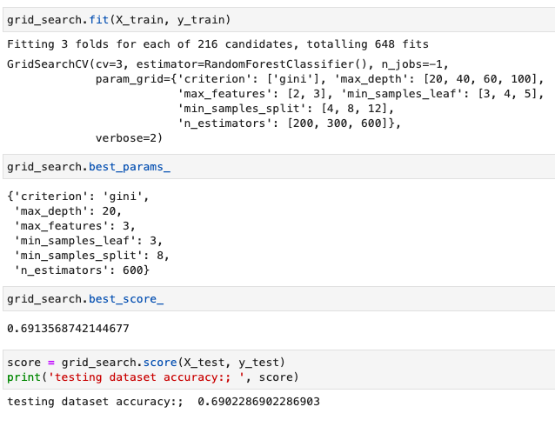
Further Hyperparameter Tuning & Results

Slide 51
Conclusion
The best overall survival prediction accuracy
83.4% with clinical dataset Only
Because high correlations between features in clinical and gene expression data, more careful selection of gene sets required

Slide 52
References
Mukherjee, A., Russell, R., Chin, SF. et al. Associations between genomic stratification of breast cancer and centrally reviewed tumour pathology in the METABRIC cohort. npj Breast Cancer 4, 5 (2018).
https://doi.org/10.1038/s41523-018-0056-8
https://www.kaggle.com/datasets/raghadalharbi/breast-cancer-gene-expression-profiles-metabric
https://medium.com/analytics-vidhya/how-to-remove-outliers-for-machine-learning-24620c4657e8
https://towardsdatascience.com/hyperparameter-tuning-the-random-forest-in-python-using-scikit-learn-28d2aa77dd74
https://www.analyticsvidhya.com/blog/2020/07/10-techniques-to-deal-with-class-imbalance-in-machine-learning/

